Slide 1
Douglas County School District Energy Services
Performance Contracting

Slide 2
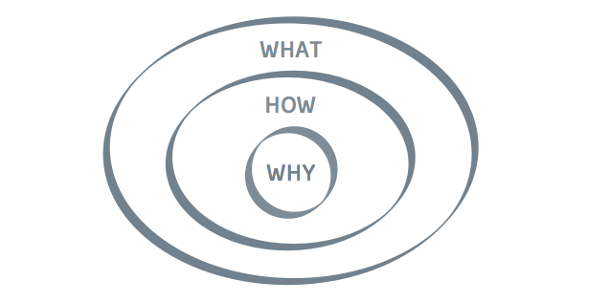
Energy Services Performance Contracting (ESPC) – Why do it?
Aged Facilities
Infrastructure and Maintenance Needs
Limited Personnel
Lack of Funds

Slide 3
DCSD’s ESPC – Project Overview
Total of 11 Energy Conservation Measure (ECMs)
District Wide Coverage
Compressed Schedule
Immediate Results = Savings

Slide 4
ESPC – Results
Sustainability
Measurement and Verification - Savings
Leveraging of FGA and Funding Sources

Slide 5
Sustainability
District-wide Material Standards Developed
Internal Energy Management System (EMS) Specialist
ESPC Measurement and Verification

Slide 6
M&V - Savings
Baseline Measurement of Guarantee
Estimated > $970K in Savings
Term = 15 Years
Select years of reporting
Accumulated Savings to-date > $96K

Slide 7
Leveraging Additional Funds
Momentum for bond initiative and approval
FGA supports “shovel-ready” projects
Qualified for ARRA grant funding
Qualified for QSCB bond funding
Rebates / Incentives
Reductions in future O&M

Slide 8
ESPC Success!
Needed Buy-In & Support
Transparency Required
Local Economic Boosts
Formal Reports Measure Guarantee
White Papers, Press Releases, DOE Case Study

Slide 9
Continuing Energy Efficiencies – Future Goals
CMMS Program
New Construction
Maintain ECMs

Slide 10
Questions?

